Slide 1
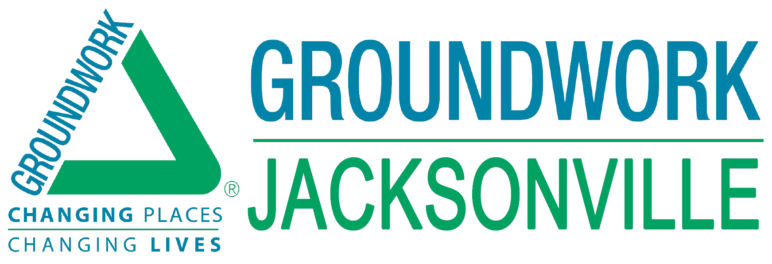
Connecting Communities by Recreating the Emerald Necklace

Slide 2
Revitalizing the historic neighborhoods of Jacksonville’s urban core by resorting and connecting the creeks and parks of the Emerald Necklace.
The Emerald Necklace Gems
McCoys Creek
S-Line Urban Rail Trail
Hogans Creek
Northbank Riverwalk

Slide 3
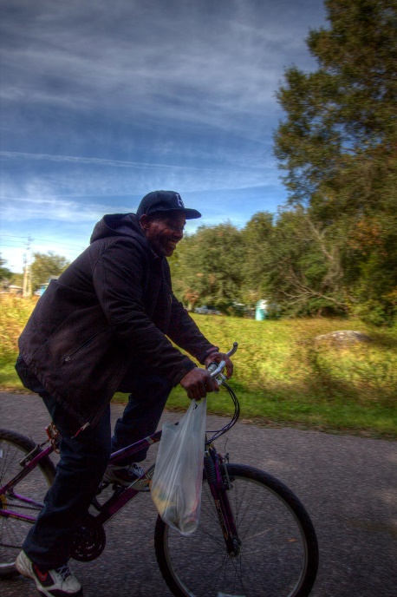
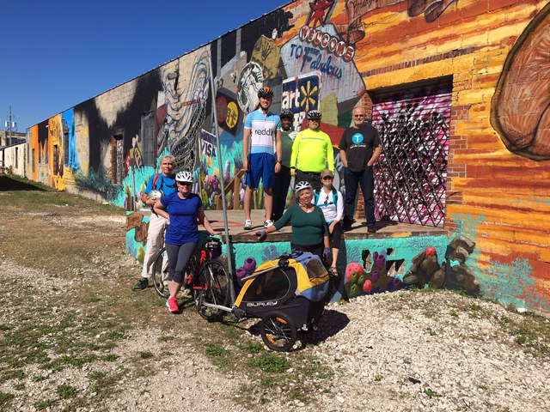
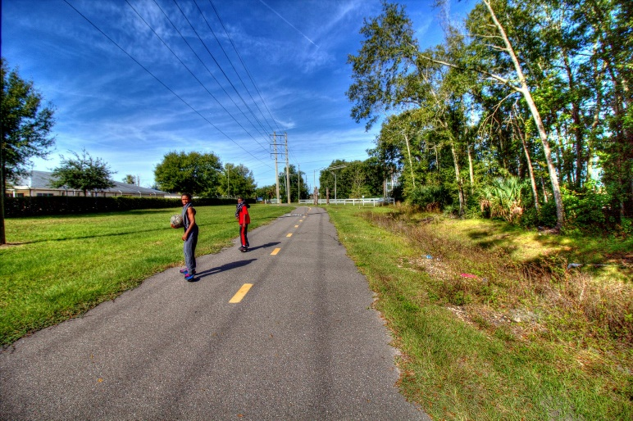
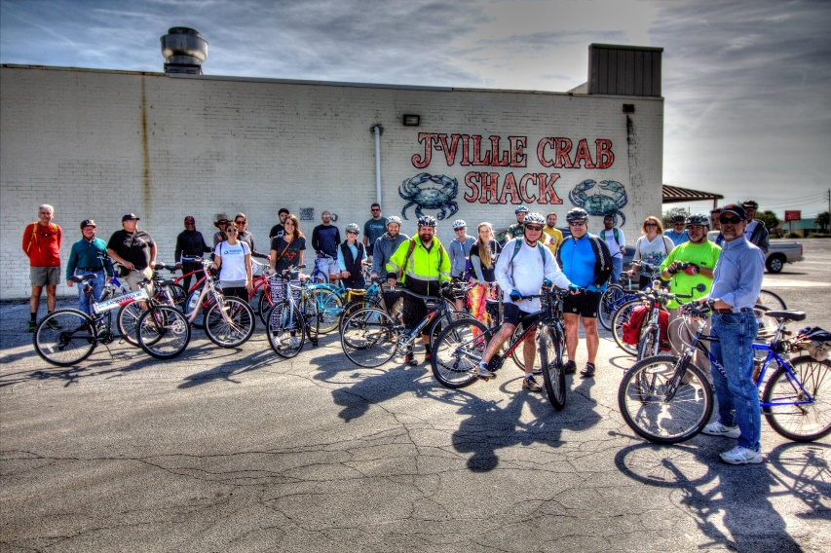
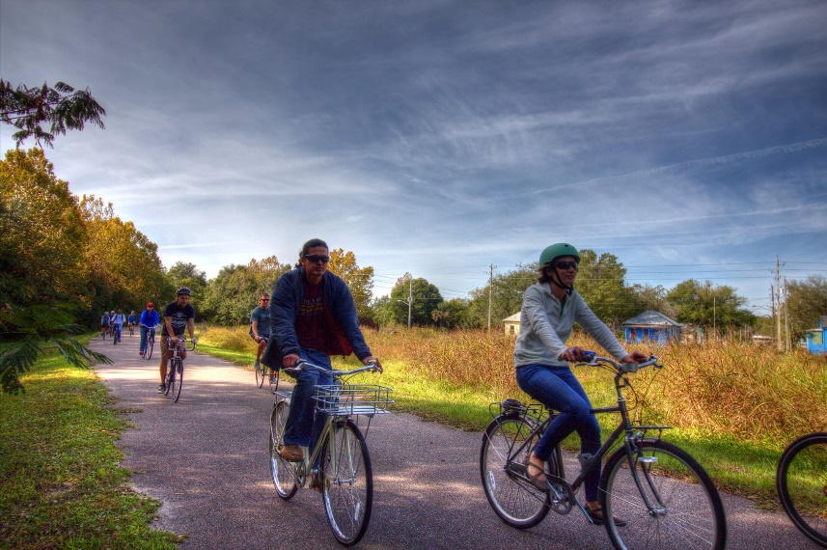
Activation of the Emerald Necklace through Recreation & Conservation Stewardship
S-Line Urban Rail Trail Bike Rides
Hosted every SECOND Saturday of the month, from 10am – 12pm
Family-friendly, slow paced bike ride
4.8 miles one-way
Next ride: March 11th
April 8th ride ending at Engine 15 Downtown Taproom and Biergarten

Slide 4
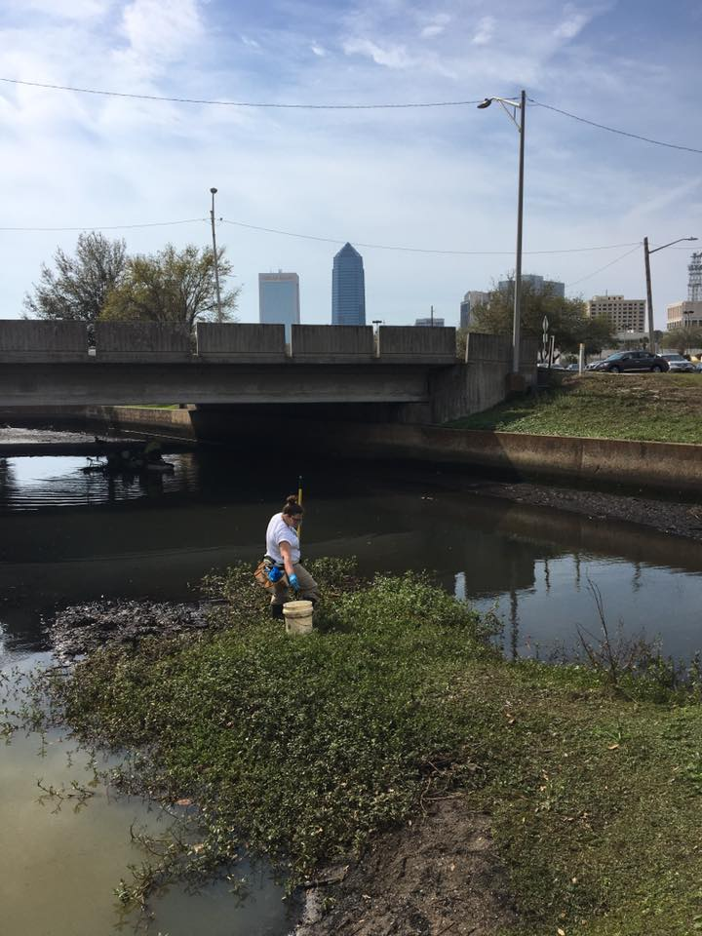
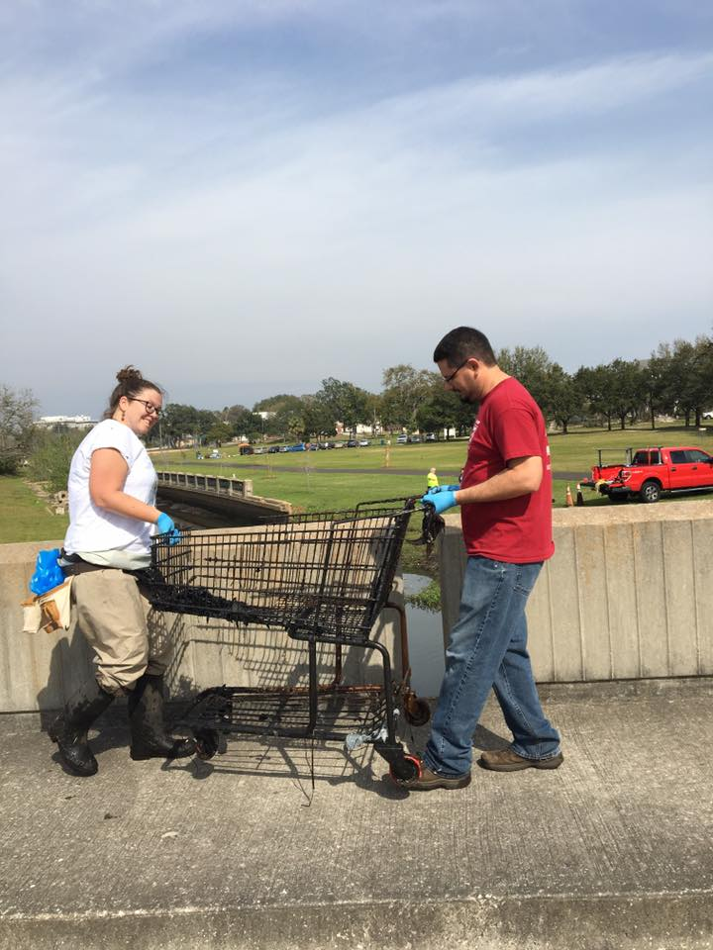
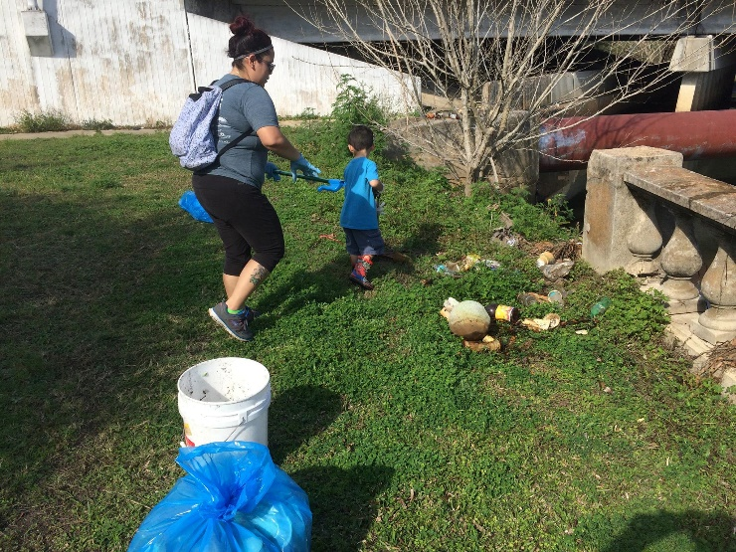
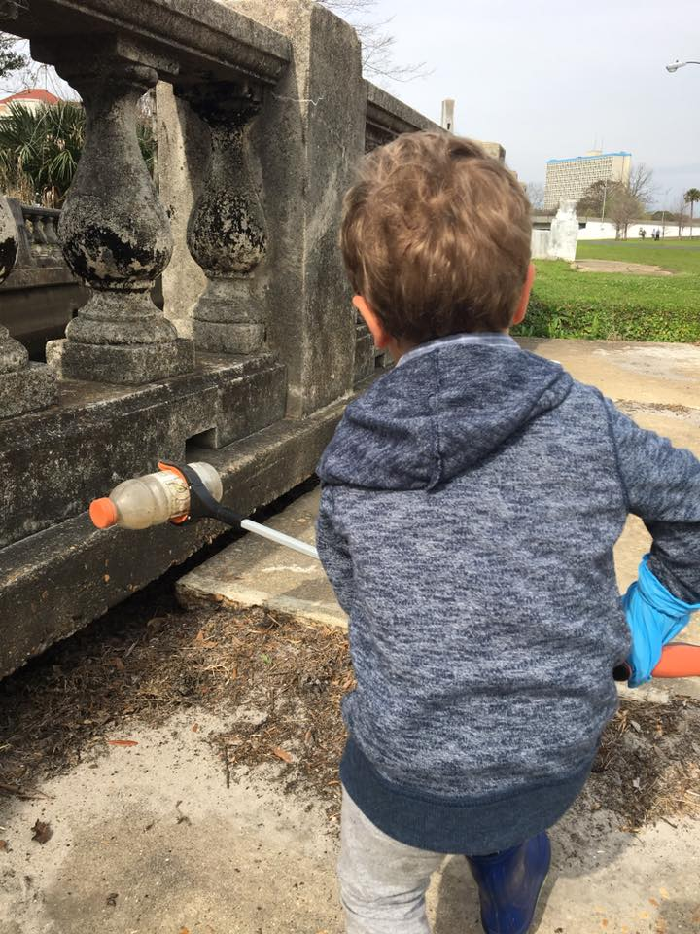
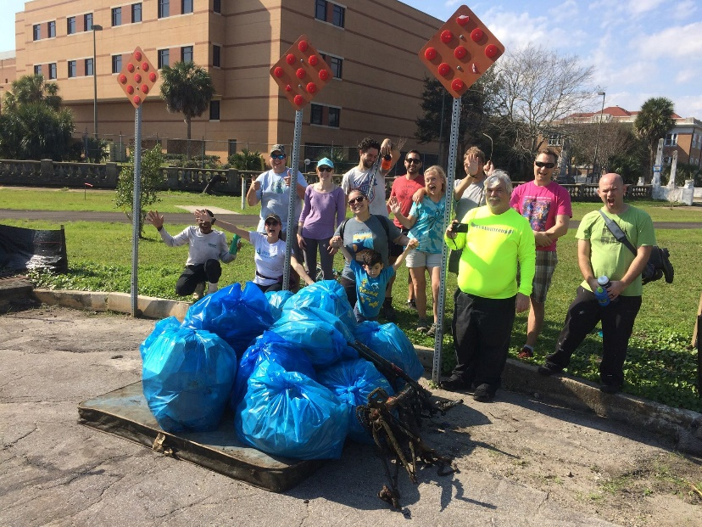
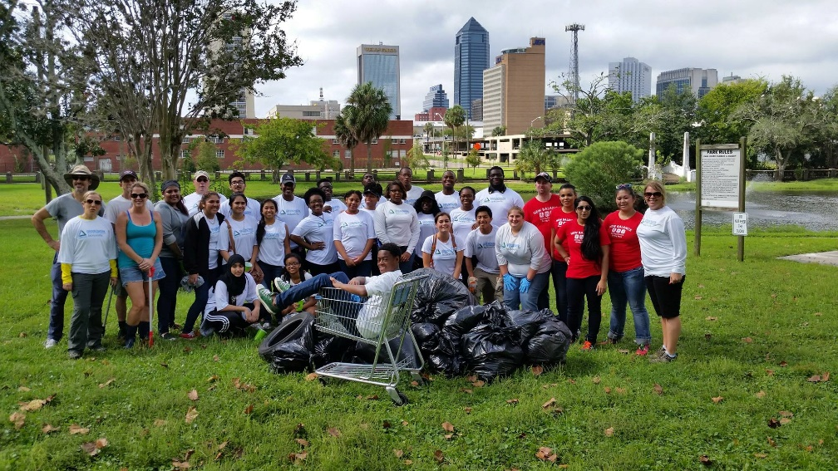
Activation of the Emerald Necklace through Recreation & Conservation Stewardship
Hogans Creek Cleanups
Hosted every THIRD Saturday of the month, from 10am – 12pm at various Hogans Creek locations
Family-friendly
Next cleanup: March 25th on the S-Line

Slide 5
For More Info…
@groundworkjacksonville
Questions…
groundworkjacksonville@gmal.com

